Slide 1

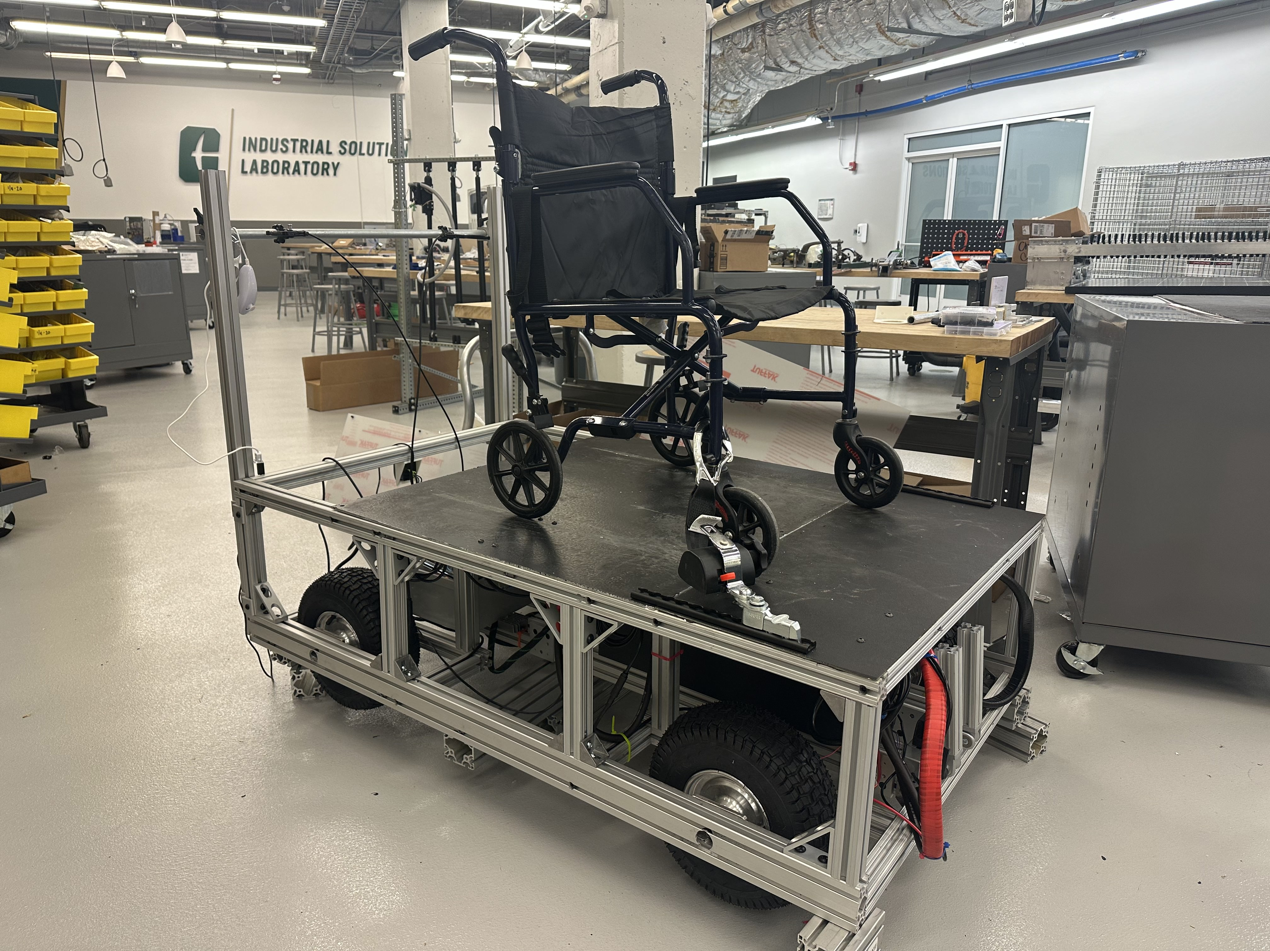
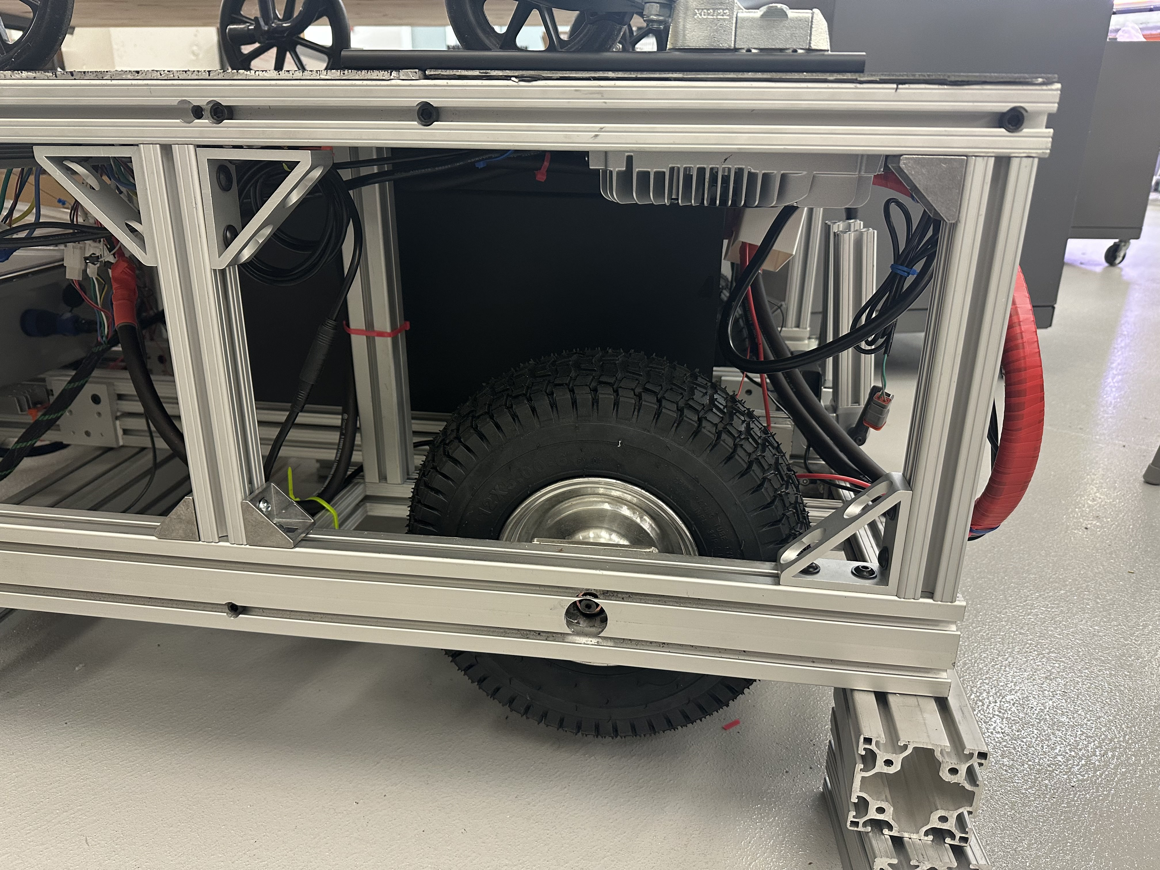
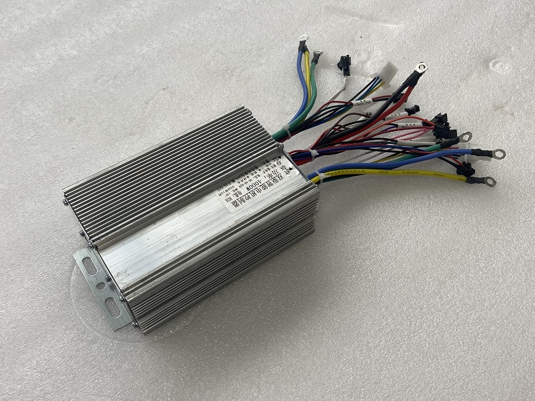
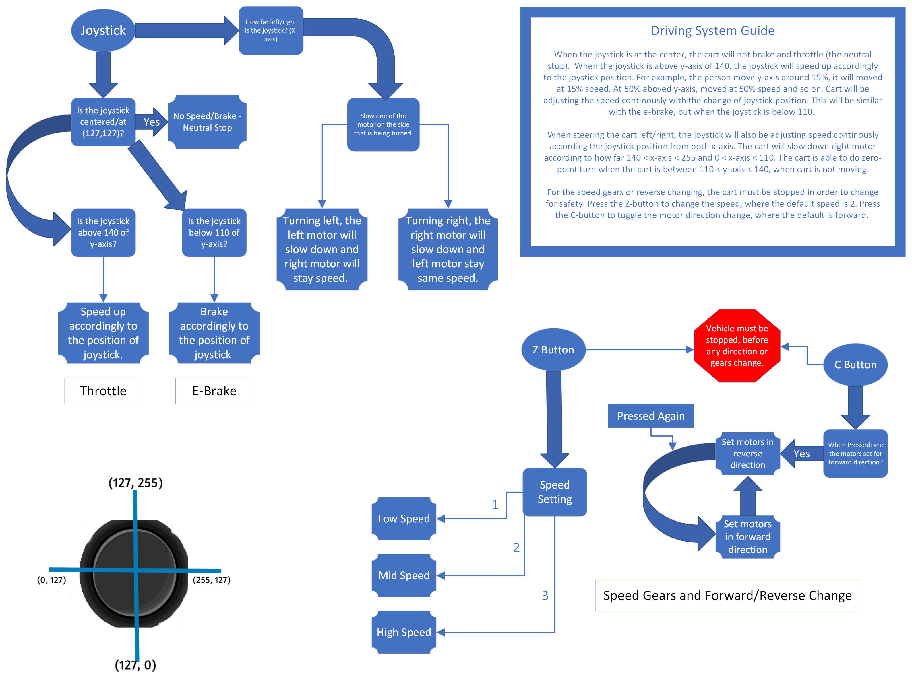
Senior Design II – Fall 2023
Ideas for Good – Adan Transport System
Facility Mentor: Michelle Demers Industrial Supporter: Brian Johanson, Douglas Corrigan
Alex Linsday (ME), Ash Rai (ME), Cale Cozad (ME), Christina Kilgore (EET), Jacob Shattuck (ME), Johnny Nguyen (CPE)
alinsday@uncc.edu, arai2@uncc.edu, ccozad@uncc.edu, mkilgor1@uncc.edu, jshattu1@uncc.edu, jnguye81@uncc.edu
Project Objective:
Wheelchair Attach/Securement
Adan Transport’s Cart
Some places, like hiking trails, zoos, farms, and sports arenas, are generally inaccessible to anyone riding in wheelchairs. The objective is to create a platform for transporting a variety of wheelchairs allowing access to otherwise inaccessible locations and ease for the escorting personnel.
AMF-Bruns of America PROTEKTOR – Platinum Series
J-hook for ease attachment. Ratcheting system for tensioning.
Support a wheelchair and a passenger load of up to 350Ibs.
RESNA WC18 approved.
Quick-Adjust Load-Securing Track
Secured to upper platform extrusion.
Allows for an array of attachment.
Design Specifications:
Wheelchairs need to securely attach to the platform, and the platform needs to have some safety systems to avoid injuries.
The platform needs to be 3 feet wide, 5 feet long, and have at least 4 inches ground clearance.
The platform needs 2 hours of battery life, a maximum speed of 2.5 to 5 mph, and the ability to climb up/down a 25° slope.
The platform needs to be remotely controlled by an outside operator.
The platform should have a durable tires for off-road, uneven terrains.
The battery needs to be enclosed and protected but should also be chargeable in the platform and removeable for servicing.
The platform needs to be durable and weatherproof.
Platform Frame
Upper Platform:
Rust-Oleum Coat Black Rugged Spray Paint
Thick rubber paint
Provides a high coefficient of friction between wheelchair and platform
Helps resists sliding in all directions*
Lower Platform:
T-slotted hollow aluminum extrusions
Brackets for non-loaded connections.
Drilled & tapped holes for loadings.
1/16” Polycarbonate panel for sides
Handlebar:
T-slotted aluminum extrusion, locking pivot and metal bar for strong support.
Adjustable height of the handlebar.
Control System: Flowchart
Control System: Features
Battery & Compartment:
Using the Wii Nunchuck, handling throttling, braking, speed and all maneuver.
In-Hub motor wheels. Motor controllers for dual wheels on each side. Built in hall-sensor.
Differential steering, capable of zero-point turning.
Bottom x-axis is used to apply braking. C-button is to change motor direction.
Manual braking on the handlebar to apply emergency parking brake.
Controller hoister on handlebar.
Battery Specification:
Nominal Rating: 51.2V, 160Ah, 8.2 kWh
10-year lifespan (~3500 cycles)
Capable of 2 hours battery charge.
Provided with a battery meter and a plug-into-wall charger.
Battery Compartment:
Sliding tray with the battery securely bolted to extrusions.
Locking pivots for leg stands

